Slide 1
Big - O Notation

Slide 2
Agenda
Introduction
Big O & Growth Rate
Examples
Big O Time Complexity Chart

Slide 3
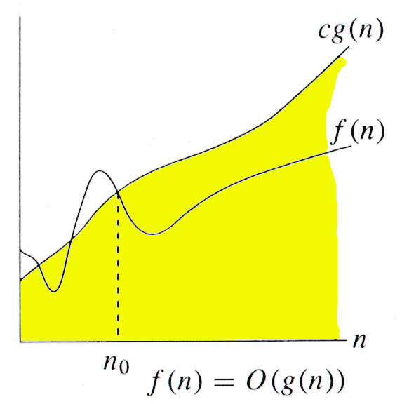
Introduction
It tells how quickly the runtime of an algorithm grows relative to the input.
It provides an upper bound of f(n) function to a constant factor within.
Given functions f(n) and g(n), we say that f(n) is O(g(n)) if there are positive constants c and n₀ such that
0 ≤ f(n) ≤ cg(n) for all n ≥ n₀
Example: 2n + 20 is O(n)
2n + 20 ≤ cn
(c − 2) n ≥ 20
n ≥ 20/(c − 2)
Picking c = 3 and n₀ = 20

Slide 4
Big O & Growth Rate
Big - O provides upper bound on growth rate of a function.
f(n) is O(g(n)) means growth rate of f(n) is not more than growth rate of O(g(n)).
Big - O is very useful to find the worst case of an algorithm, i.e Big - O says the algorithm is at least this good.

Slide 5
Examples
7n -2 → It is O(n)
We need c>0 and n₀ ≥ 1 such that 7n-2 ≤ c * n for n ≥ n₀
The above holds true for c = 7 and n₀ = 1
3 log n + 5 → It is O(logn)
We need c>0 and n₀ ≥ 1 such that 3 log n + 5 ≤ c * log n for n ≥ n₀
The above holds true for c = 8 and n₀ = 2
3n³ + 20n² + 5 → It is O(n³)
We need c>0 and n₀ ≥ 1 such that 3n³ + 20n² + 5 ≤ c * n³ for n ≥ n₀
The above holds true for c = 4 and n₀ = 21

Slide 6
Example
int num = 0;
for (j = 0; j < n; j++) {
for (i = n; i > j; i--) {
num = num + i + j;
}
}
The above will run as follows:
= n + (n – 1) + (n – 2) + … 1 + 0
= n* (n + 1) / 2
= 1/2 * n^2 + 1/2 * n
O(n^2) times or O(n*n) times

Slide 7
Example 3
Consider the following code snippet
for (i = no / 2; i <= no; i++) {
for (j = 2; j <= no; j = j * 2) {
k = k + no / 2;
}
}
In the above code , j keeps on doubling until it is less than or equal to the no.
For eg : if no = 8 , j=2,4,8
If no = 16, j=2,4,8,16
We can double a number till it is less than n would be in log(n)
Therefore, j will run for O(logn), i runs for n/2.
Hence, total steps = O(n/2*log(n)) = O(n*logn)

Slide 8
Big O Time Complexity Chart
Time Complexity | Type | Example
O(1) | Constant → Desirable | Adding element front of linked list
O(log n) | Log → Excellent | Finding an element in a sorted array
O(n) | Linear → Very Good | Finding an element in an unsorted array
O(n log n) | N log N → Good | Sorting N elements using Divide & Conquer
O(n²) | Quadratic → OK | Using nested for loop
O(n³) | Cubic → Bad | Solving simultaneous linear equations
O(d^{n}) , d > 1 | Exponential → Very Bad | Tower of Hanoi

Slide 9
Summary
We have learned about Big O notation along with examples and got to know that Big - O provides upper bound on growth rate of a function.
We have also seen a general Big O Time complexity chart.

Slide 10
Thank You
Proprietary content. ©Great Learning. All Rights Reserved. Unauthorized use or distribution prohibited

